Slide 1
DIGITAL
MOBILE
SIMPLE
EFFECTIVE
Mobile Warehouse Management for SAP Business One
COBI.wms Solution Overview

Slide 2
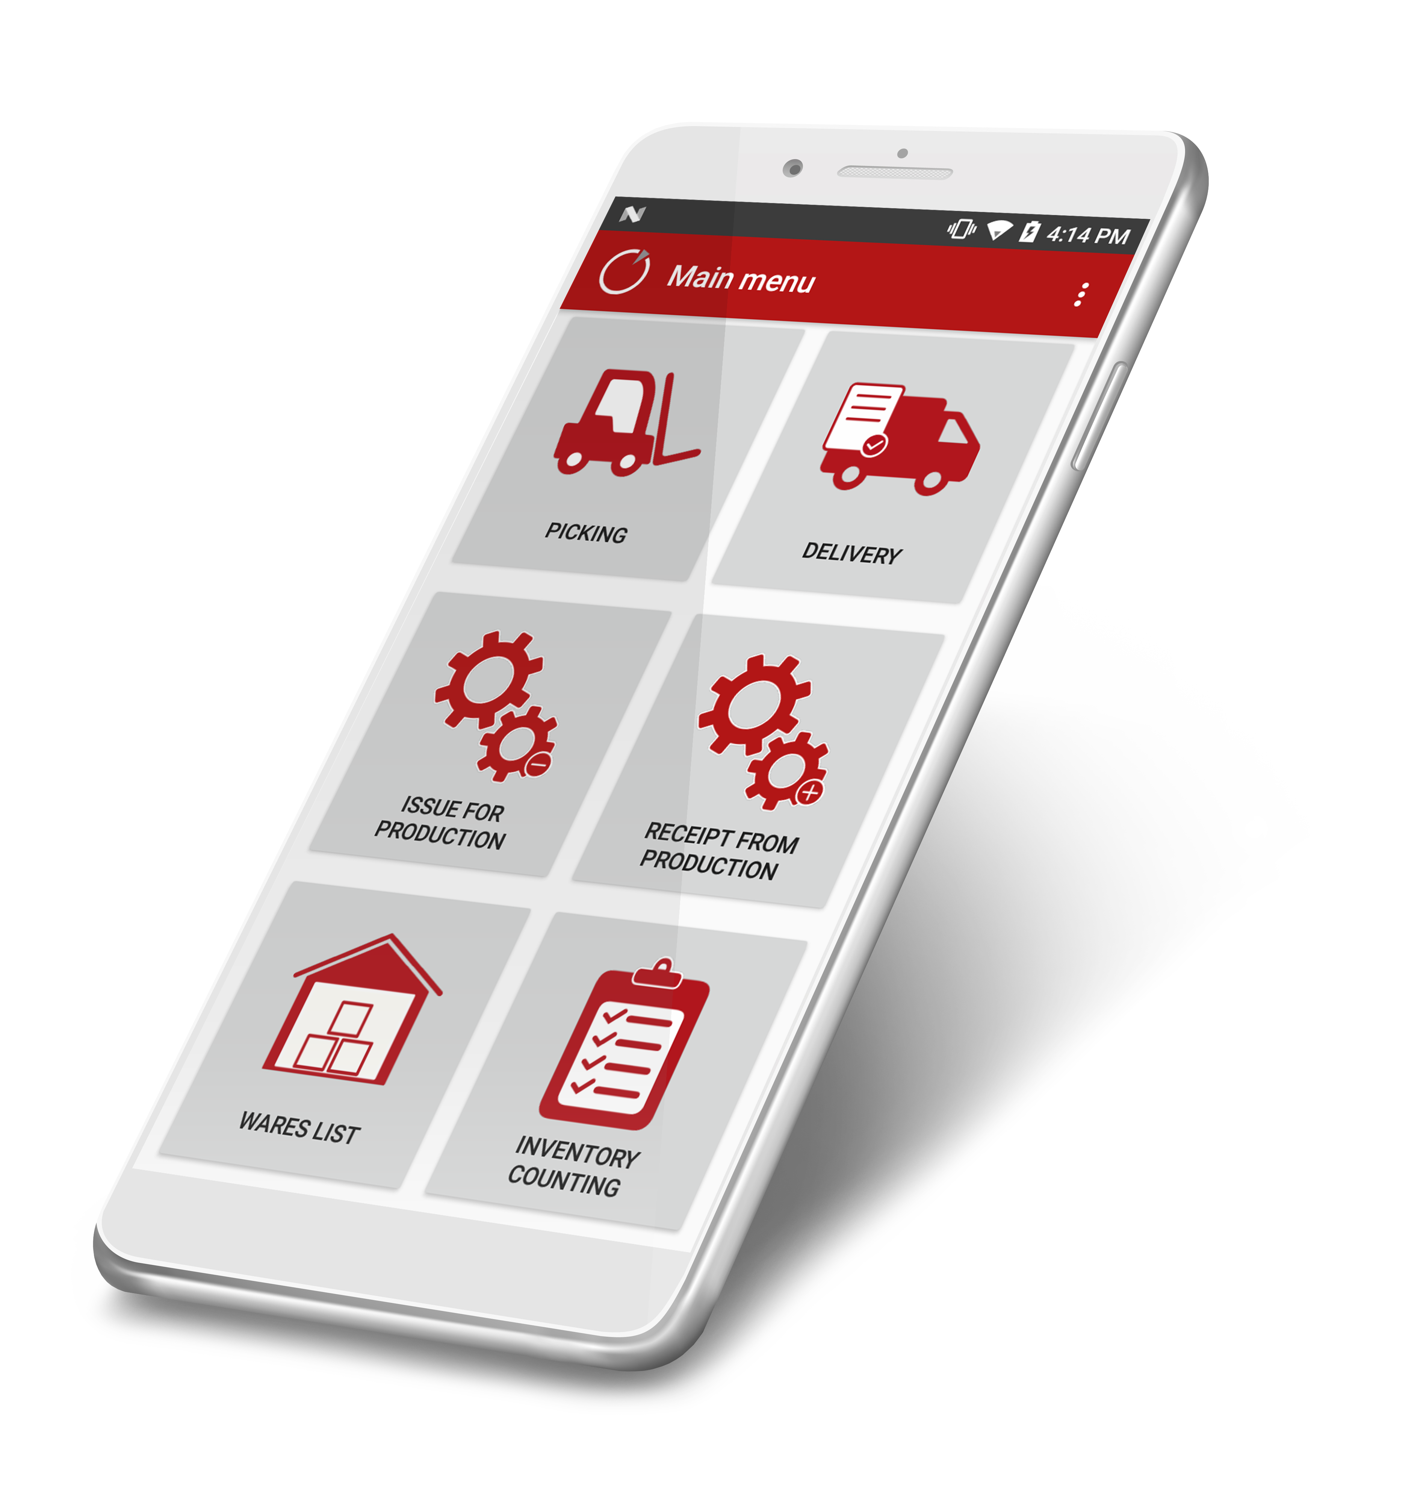
Mobile Warehouse Management for SAP Business One
COBI.wms is the modern solution for a simple and mobile warehouse management. Accurate and streamlined inventory management is crucial to your ability to deliver on promise, as well as to maintain customer satisfaction and inventory cost control.
As a reliable add-on, COBI.wms offers you the possibility to book all activities from the warehouse directly into SAP Business One. Multiple warehouses with and without bin locations can be handled as well.
Thanks to simple implementation and future-oriented mobile technology, you can boost the productivity and efficiency of your business.
Increase productivity as a result of time saved and simplified mobile transactions
Avoid duplicate work and eliminate paperwork by booking directly from the warehouse into SAP Business One
Easily and intuitively use any android device of choice

Slide 3
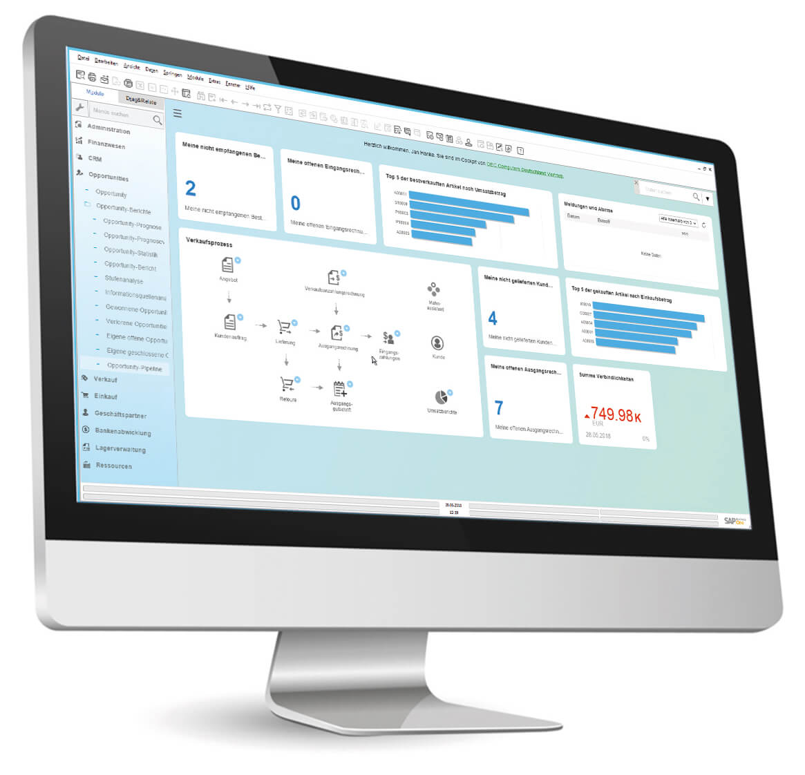
Make it Simple with Full Integration
In today’s fast paced and ever changing business world, the warehouse needs to connect into many other departments of the business to provide critical information in real time so that you can extract insights to meet customer demand and expectations.
COBI.wms contains fully integrated functions for modern warehouse logistics in SAP Business One. It also has a multilingual user interface and can be used internationally.

Slide 4
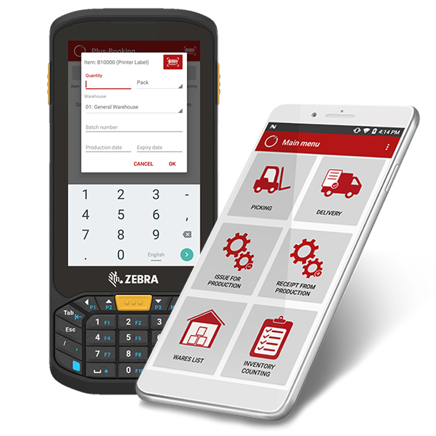
Whatever your Device of Choice is, we‘ve got you Covered
The app is compatible both with Android-based as well as Bluetooth barcode scanners and standard Android smartphones and tablets. It comes with various standard modules that are equipped with innovative features.
Supported Android scanners and devices:
Honeywell
Zebra
Panasonic
DataLogic
Android Smartphones Version 8.1 and higher

Slide 5
Take Advantage of Extensive Mobile Functionality
Productivity
Real-Time Data
Mobility
Proactively meet your warehouse management demands and reduce errors and training costs.
Improve your inventory and supply chain management by running COBI.wms flexible, mobile and fully integrated.
Achieve real-time synchronization of goods receipts and warehouse inventory.
Generate reports in SAP Business One with real-time data or monitor your stock and items on the go with the mobile COBI.wms app.
Offer your employees the opportunity to use business processes anywhere and anytime with the mobile device of their choice and automatically reduce downtime in your company.

Slide 6
Designed for all Small and Midsize Warehouse Management Needs
Affordable
Low total cost of ownership at simultaneous
cost savings
Across Devices
Compatible with Android barcode scanners and Android smartphones and tablets
Quick Implementation
Commissioning within one day
Fully Integrated
Based on the well-known SAP Business One functionalities
Multilingual
Available in German, English, Turkish and Spanish
French is coming soon
Dynamic
Features / Options can be locked or unlocked as per the requirement for the enduser or per device

Slide 7
Standard Modules

Slide 8
Standard Modules
The application enriches your SAP Business One solution with various standard modules:
Plus-Booking
Minus-Booking
Purchase Receipt
Inventory Transfer
Purchase & Sales Return
Issue for Production
Purchase Order
Picking
Sales Delivery (with Packing Slip)
Inventory Counting
Inventory List
Label Printing
Receipt from Production
Transfer Request

Slide 9
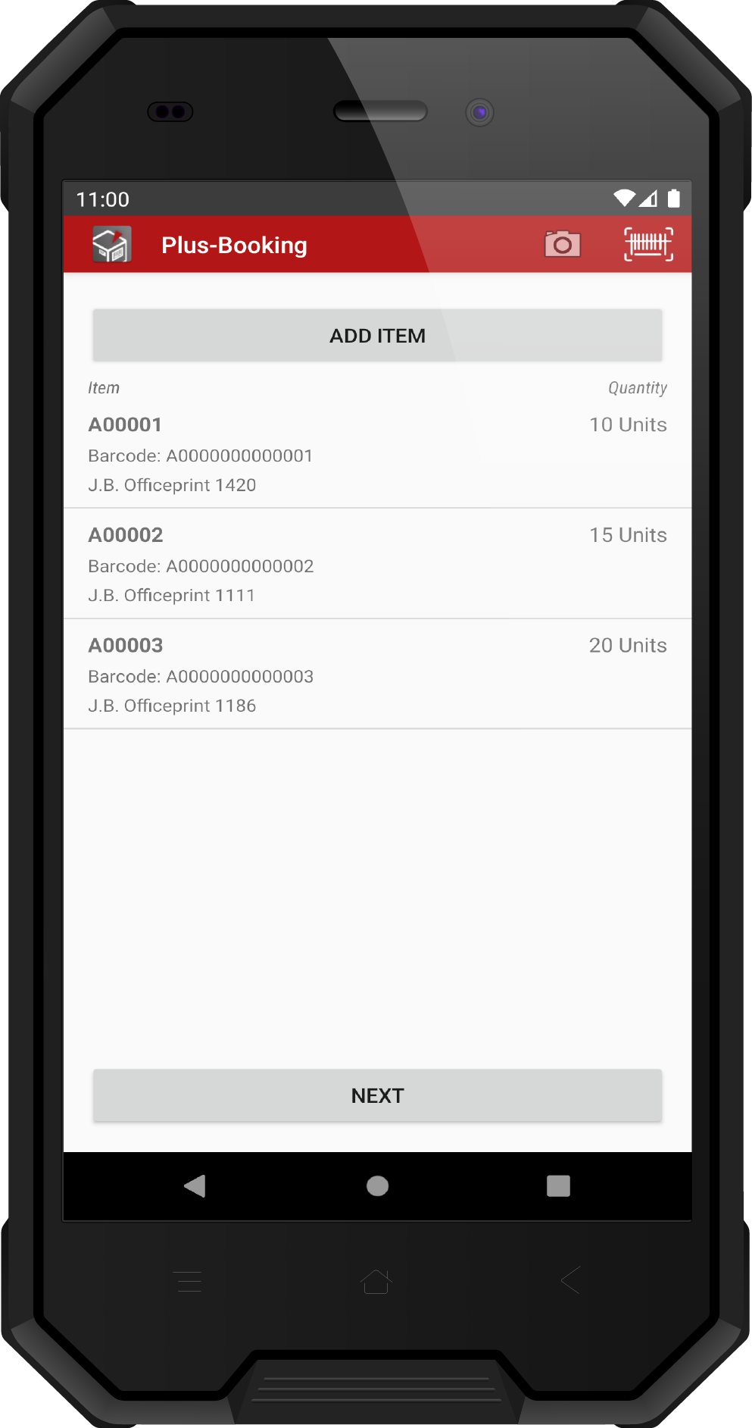
Plus-Booking
Simply book an increase in inventory without reference to specific business processes such as purchase orders.
Book incoming goods
Search articles quickly
Barcode scanning
Units of measurement
Batch and serial numbers
Bin locations
Photo function

Slide 10
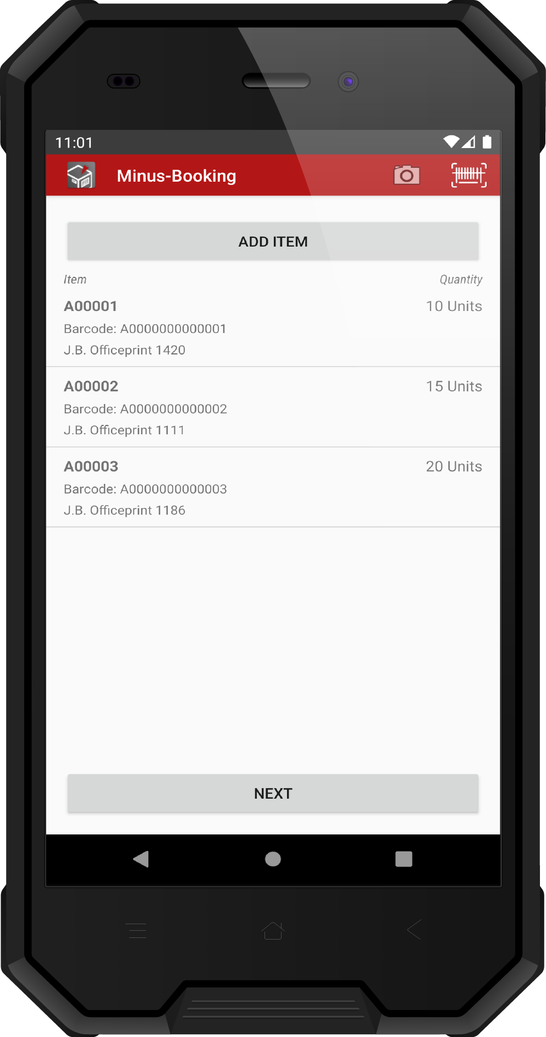
Minus-Booking
Book a reduction in stock quantity without reference to specific business processes such as sales orders.
Book outgoing goods
Search articles quickly
Barcode scanning
Units of measurement
Batch and serial numbers
Bin locations
Photo function

Slide 11
Inventory Transfer
Book inventory transfers from warehouse to warehouse, or between bin locations.
Perform inventory transfer
Support for Inventory Transfer based on Inventory Transfer Request
Search articles quickly
Barcode scanning
Units of measurement
Batch and serial numbers
Bin locations
Photo function

Slide 12
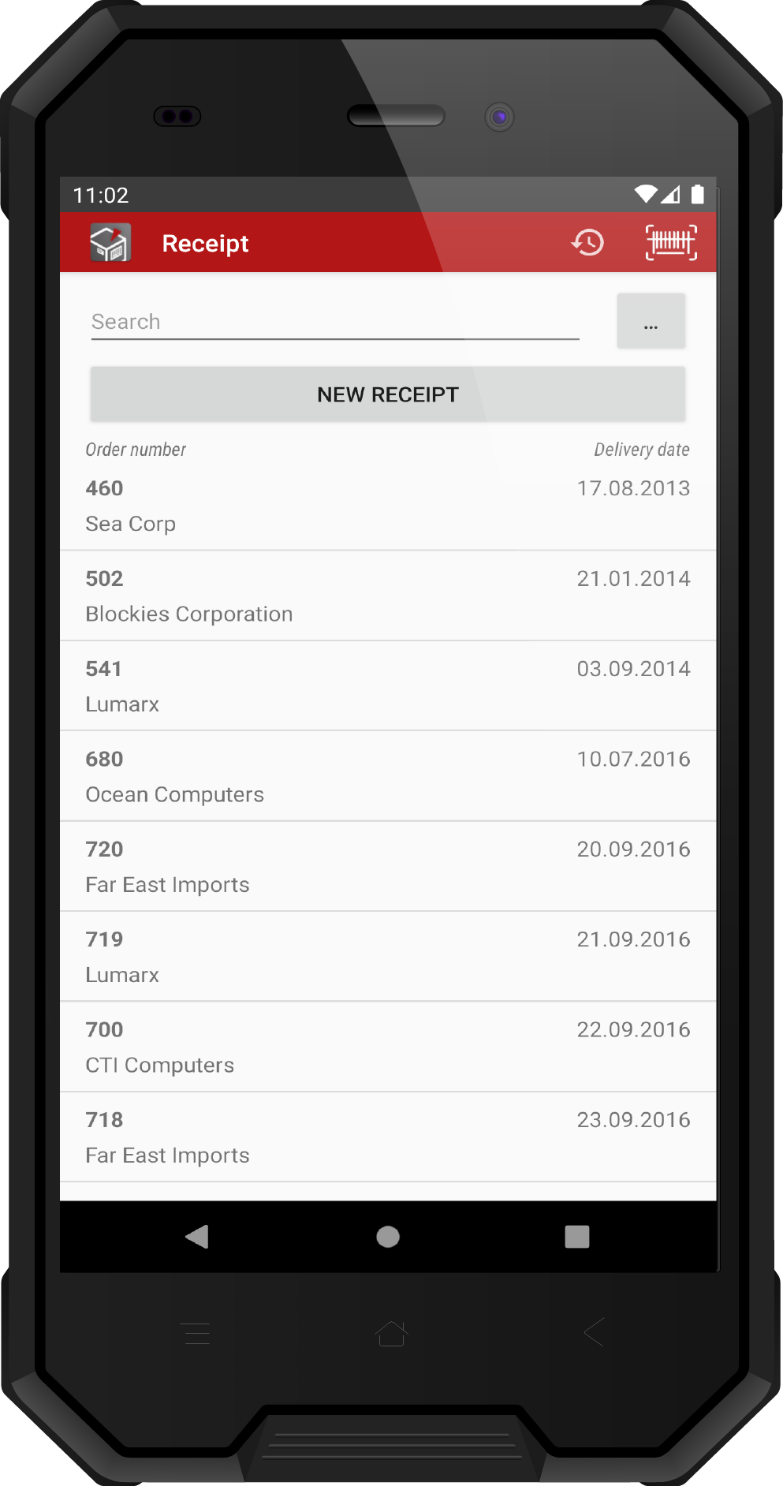
Purchase Receipt
Book goods receipts based on purchase orders or ad hoc with reference to a supplier.
Book a receipt of many purchase orders at once
Book a goods receipt based on the purchase order
Book a document against a vendor
Search articles quickly
Barcode scanning
Units of measurement
Batch and serial numbers
Bin locations
Photo function

Slide 13
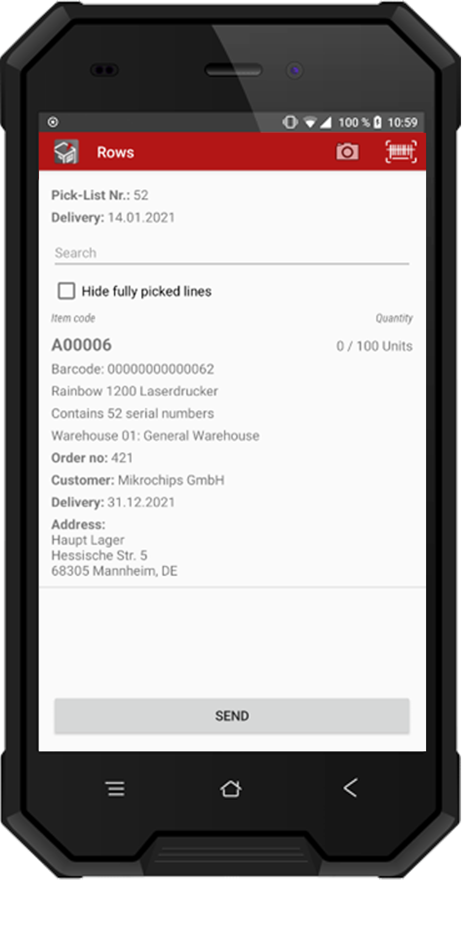
Picking
See sales orders open for picking, process released picking lists, and create delivery notes based on completed picking list lines.
Show open sales orders (not released for picking)
Show and edit released picking lists
Create delivery for one or multiple completed picking lists
Support for Pick Lists based on Inventory Transfer Requests
Barcode scanning
Units of measurement
Batch and serial numbers
Bin locations
Photo function

Slide 14
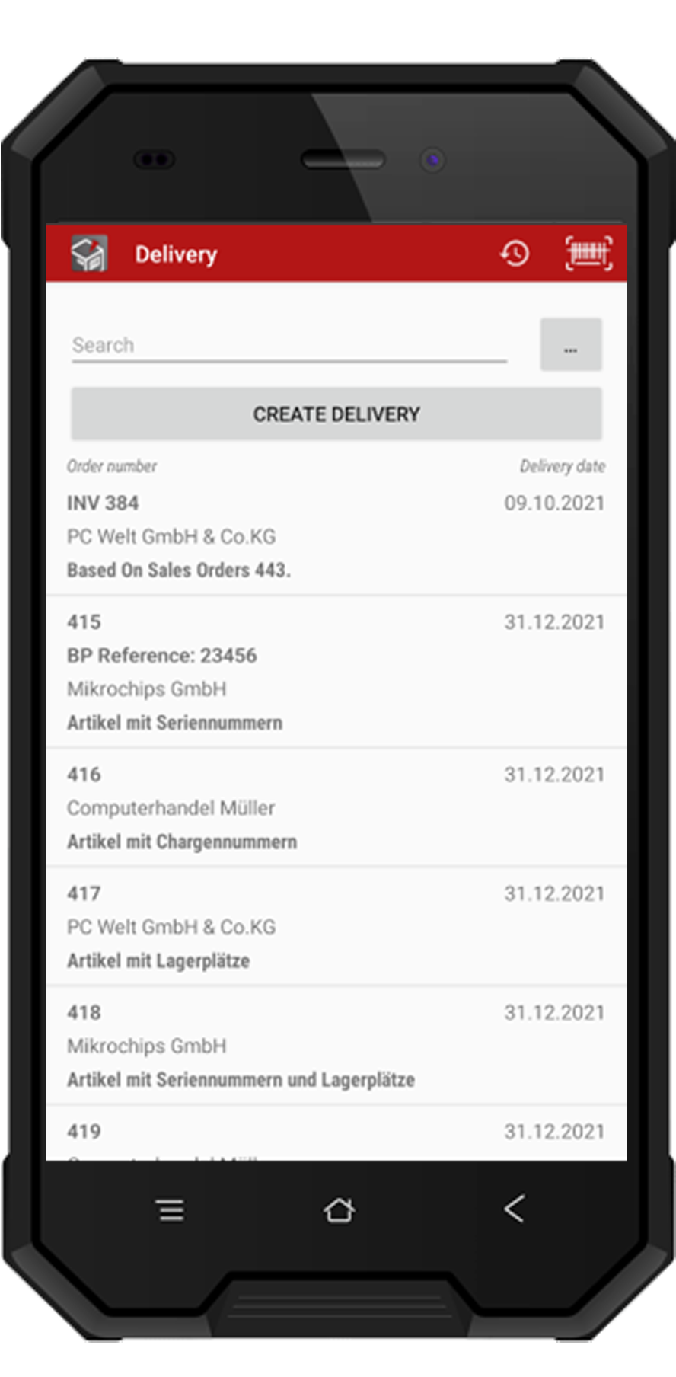
Sales Delivery
Book deliveries based on orders, or ad hoc with reference to a customer.
Book a delivery based on a sales order and reserve invoice
Create package slip
Create joint deliveries
Search articles quickly
Barcode scanning
Units of measurement
Batch and serial numbers
Bin locations

Slide 15
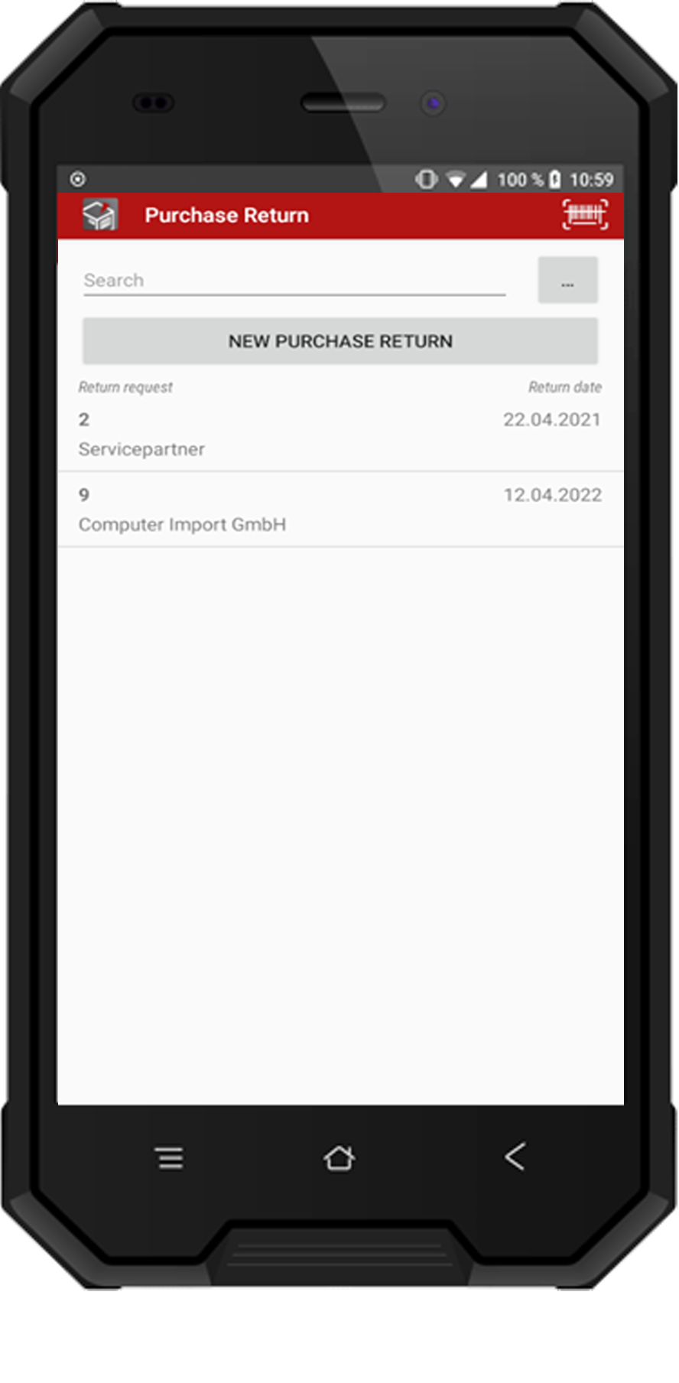
Purchase Return
Book the outgoing delivery of returned goods
Scan barcode to select return request by number
Live search in return request list
Early warning if specified quantity exceeds available
Add photo attachments

Slide 16
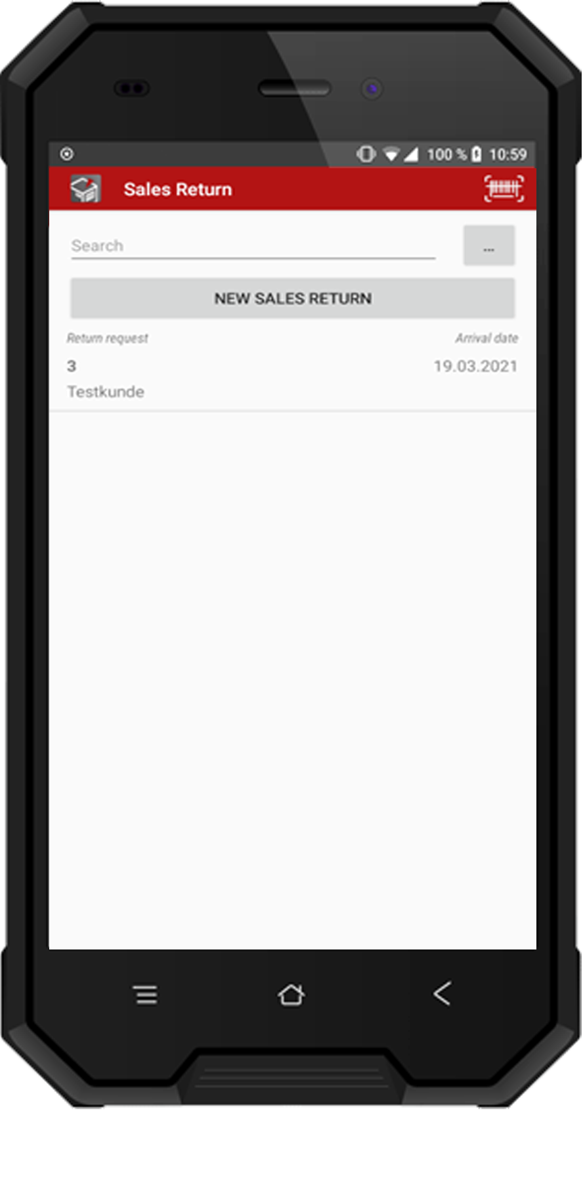
Sales Return
ION
Book the receipt of returned goods
Scan barcode to select return request by number
Live search in return request list
Early warning if specified quantity exceeds available
Add photo attachments

Slide 17
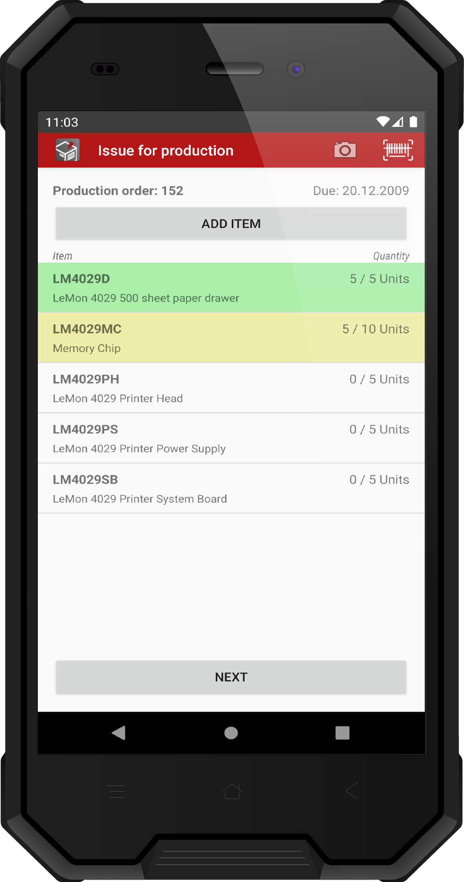
Issue for Production
Book the issuing of components from the warehouse to production.
Book outgoing goods in relation to production order
Support for Disassembly Production Order
Search articles quickly
Barcode scanning
Units of measurement
Batch and serial numbers
Bin locations
Photo function

Slide 18
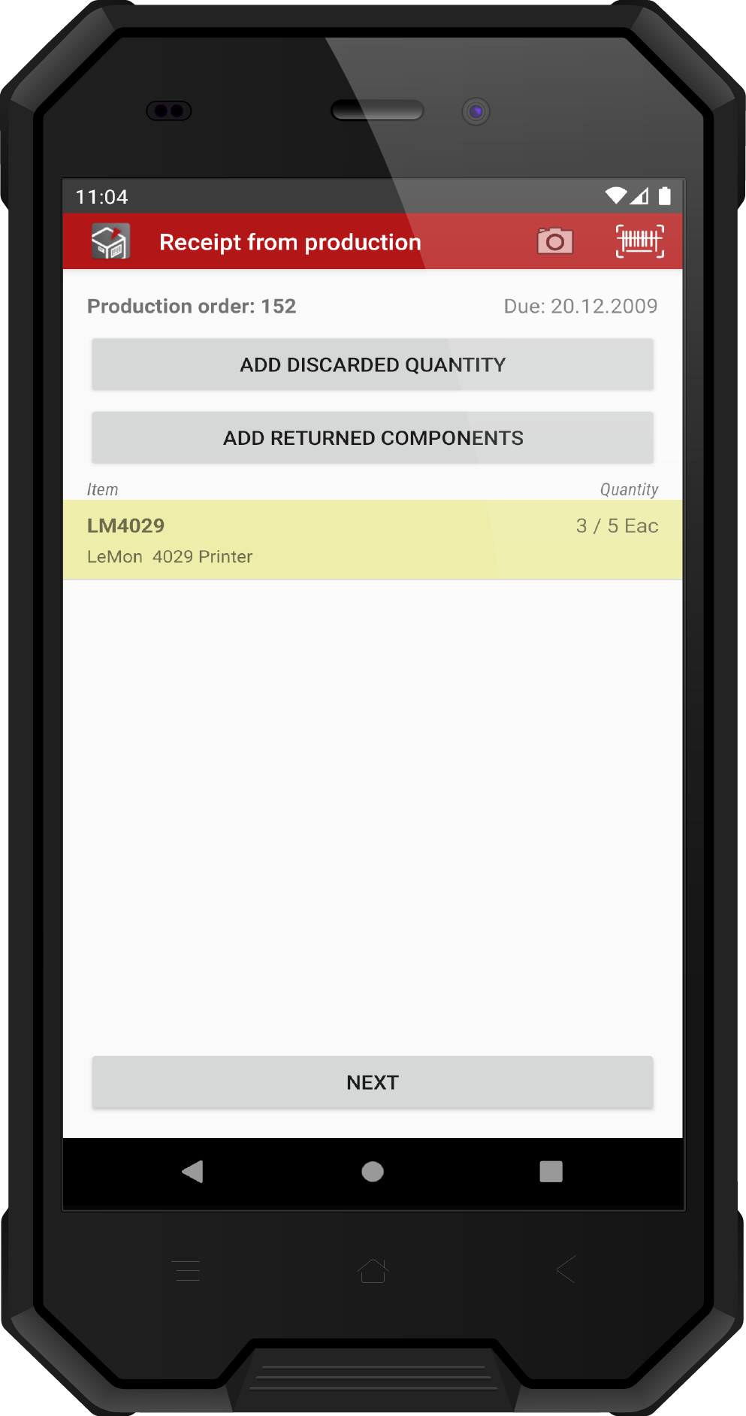
Receipt from Production
Book the receipts of finished products from production to the warehouse.
Book incoming goods in relation to production order
Support for Disassembly Production Order
Quick search article
Barcode scanning
Units of measurement
Batch and serial numbers
Bin locations
Photo function

Slide 19
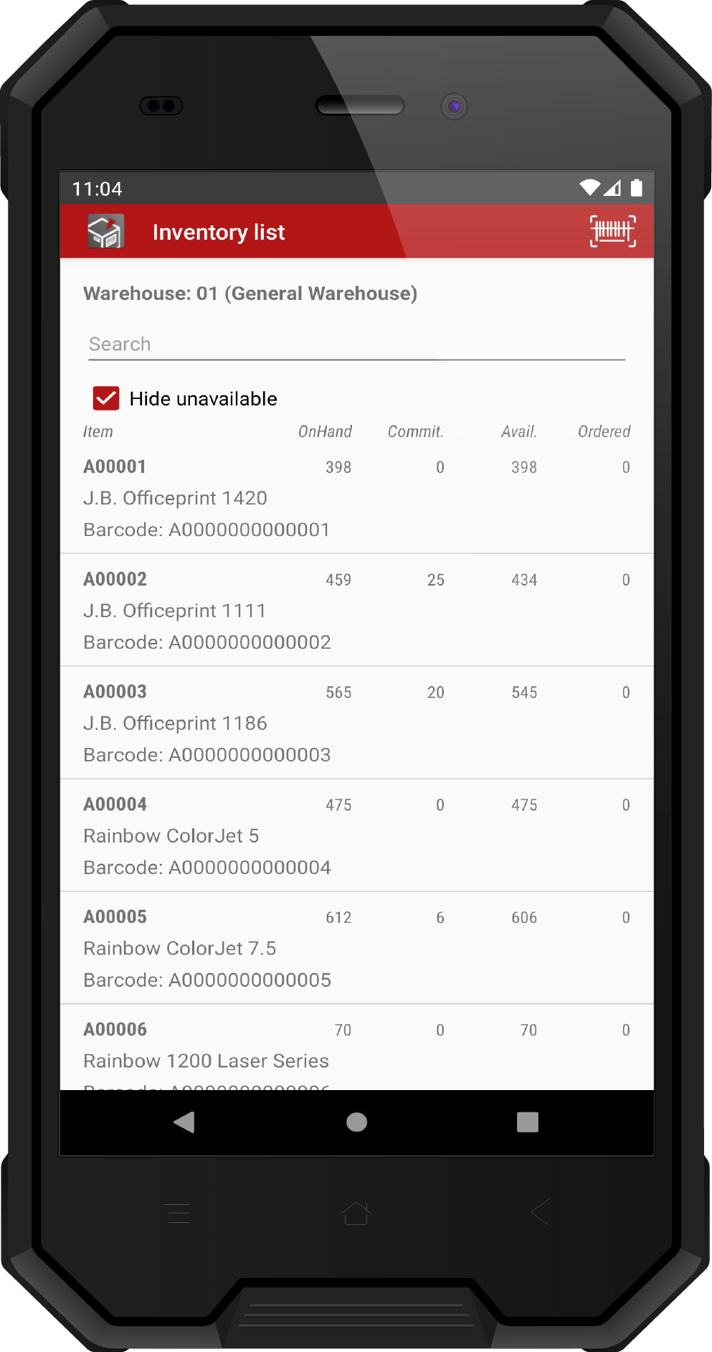
Inventory List
Get a quick look at your inventory levels, including batch and serial numbers, and a breakdown of your bin locations.
Overview of all items in warehouse
Dynamic search
Filter by availability
Quantities per bin location
Quantities per batch number
Available serial numbers

Slide 20
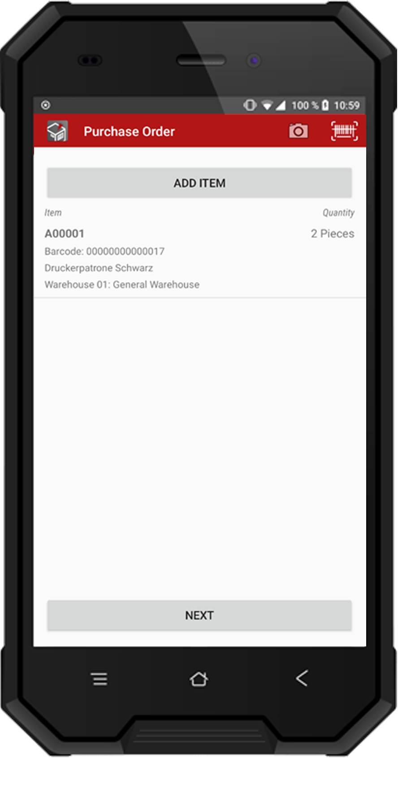
Purchase Order
Create a new purchase order
Barcode scanning
Live search in supplier list
Units of measurement
Photo function

Slide 21
Request order
Creating a request for an order
Barcode scan
units of measure
Photo function

Slide 22
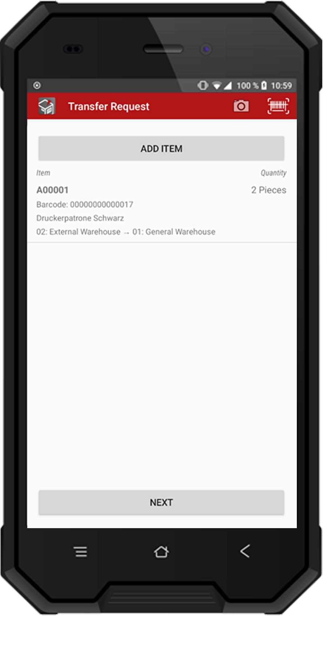
Transfer Request
Modules
Create a new transfer request
Barcode scanning
Live search in item list
Units of measurement
Photo function

Slide 23
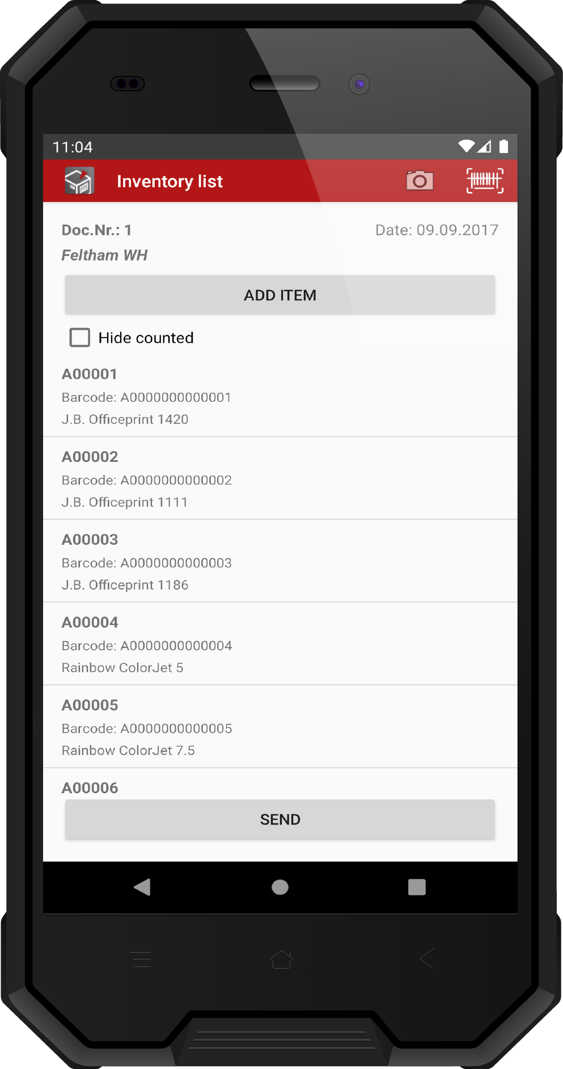
Inventory Counting
Count your inventory on the mobile device and book it directly into your digital counter list.
Show and edit inventory counting lists
Barcode scanning
Units of measurement
Batch and serial numbers
Bin locations
Photo function

Slide 24
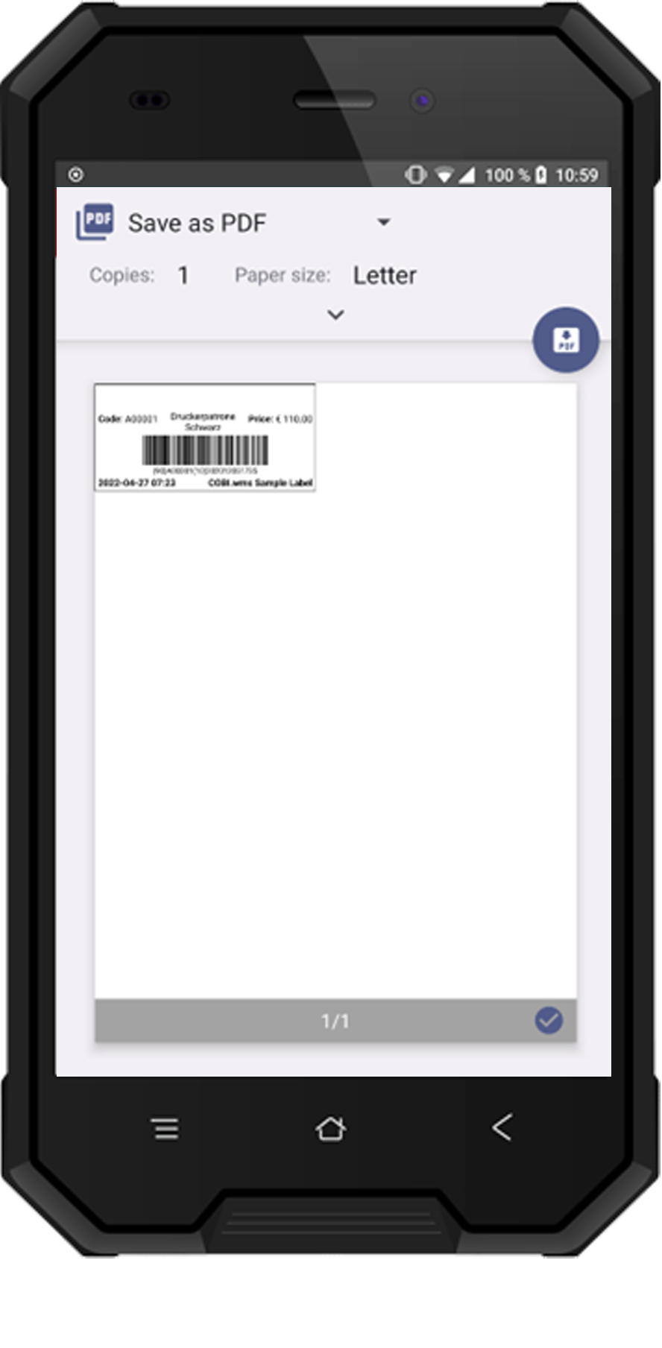
Label Printing
Print wares labels directly from the app
Import custom label templates
Print via the standard print services of the Android system
Print by connecting to a network-capable and ZPL-compatible label printer

Slide 25
Further Settings
COBI.wms offers the user to disable/enable functions at any time. Click on Options in the app and design COBI.wms according to your company‘s workflow.
Barcode Scanning
Scan to add quantity
Barcode Scan via Bluetooth keyboard
Batches and Serials
Make expiry date mandatory
Batch number details
Serial number details
Global serials
Delivery
Copy delivery date from Sales Order
Delivery packing slips
Delivery packing slips/Unified workflow
Delivery packing slips/SSCC generation
Delivery packing slips/Batches and Serials
Miscellaneous
Show non-inventory items in item list
Allow negative stock
Auto-select default bin location of item
Picking
Pick list lines in overview
Quick picking workflow
Receipt from Production
Dis-/allow closing of production orders

Slide 26
Quick Facts

Slide 27
Benefits at a Glance
Commissioning within one day
Management of licenses, devices, users
Lock/unlock modules per device/user
Android barcode scanner supported
Barcode scan with smartphone camera
Dynamic search function
Bin locations supported
Available in German, English, Turkish, Spanish, Polish and French
Batch and Serial Numbers
Quantity units
GS1 barcode standard
Photo attachement function
Multi-client capable
Supported hardware: Honeywell, Panasonic, Zebra, etc.
Customer-specific special functions and branding e.g. recipe production, cold store connection and scale connection

Slide 28
Learn More
See for yourself how you can work with COBI.wms to structure your warehouse logistics and mobilize them.
Documentation
Google Play Store
www.cobisoft.de/en
28

